Slide 1
WELCOME TO MY PRESENTATION
Bangladesh at a glance
Name: Mst. Nasrin Akter
Batch:18
Roll:19

Slide 2
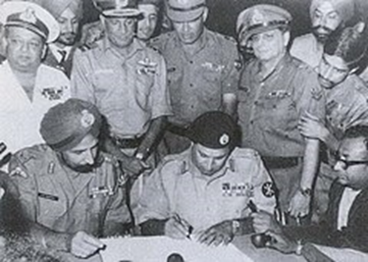
Independence Of Bangladesh
The Independence of Bangladesh was declared on 26 March 1971, celebrated as Independence Day, from Pakistan. The Independence Day of Bangladesh is celebrated on 26 March when Sheikh Mujibur Rahman declared the independence of Bangladesh.

Slide 3
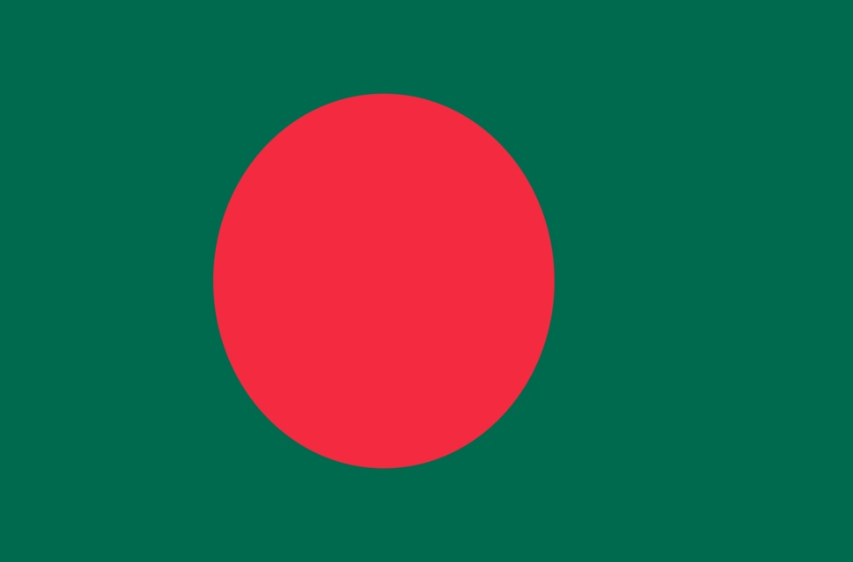
National Flag Of Bangladesh
The national flag of Bangladesh was adopted officially on 17 January 1972. It consists of a red circle on top of a dark green banner

Slide 4
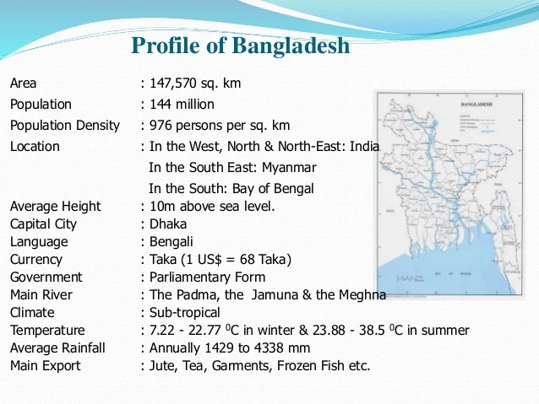

Slide 5
Sources of Natural beauties
Sources of natural beauties
Beauties of Sundarbans
Beauties of sea beaches
Chittagong hill tracts
Beauties Of rivers

Slide 6
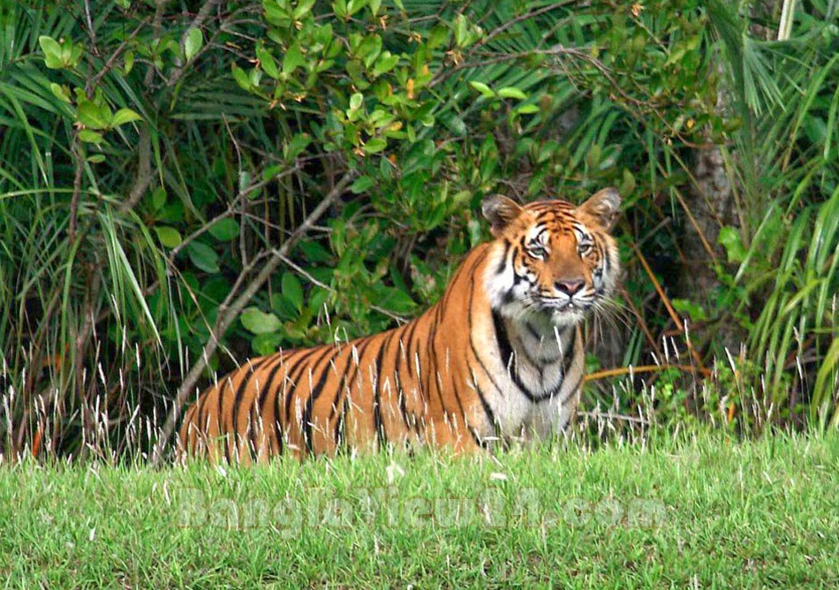
Beauties Of Sundarbans
The Sundarbans mangrove forest, measuring about 10,000 sq km, lies on the delta of the Ganges, Brahmaputra and Meghna rivers on the Bay of Bengal. It is one of the largest forests in the world of which 40% lies in India. The Sundarbans Mangroves Ecoregion is the large-scale mangrove ecosystem in this Universe, the name deriving from the supreme mangrove species present in this region, Heritiera fomes, which is locally familiar as sundri.

Slide 7
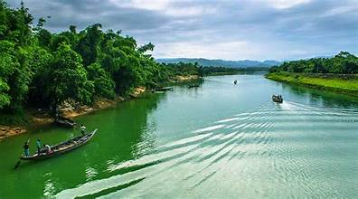
Beauties Of Rivers
Bangladesh is a riverine country. According to Bangladesh Water development board (BWDB)^{[1]} about 907 rivers currently flow in Bangladesh (during summer and winter), although the numbers stated in some sources are ambiguous.^{[2][3][4]} As stated by a publication called by BWDB (Bangladesh Water development board), 310 rivers flow in the summer although they republished another study in 6 volumes where stated 405 rivers.

Slide 8
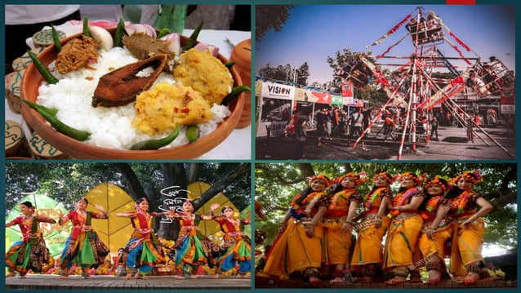
Festivals Of Bangladesh
Festivals in Bangladesh fall into four major categories: religious festivals, national events, cultural festivals and tribal festivals. Although a few festivals are primarily meant for particular sections of the population, all the festivals have now attained universal reach throughout the country.

Slide 9
THANK YOU

